Slide 1

University Campus Networking
Team (3):
Hend Mostafa tawfik Mohamed
Yasmin AbdulMonem AbdulRahman Azab
Nashwa Eltokhy Adly Barak
Christeen Nader Melek yasa
Faiza adel emam

Slide 2

scenario
Overview of the Project: design of university system network (internal network) this topology aims to facilitate communication between university administration and the colleges [medicine , engineering , nursing , computer science ]

Slide 3

Project Objectives
Key Goals:
1.Formulate and implement a hierarchical network model.
2.Incorporate redundancy for reliability.
3.Create wireless networks for departments.
4.Implement distinct VLANs and subnets.
5.Use BGP for routing.
6.Enable seamless communication across the university.

Slide 4
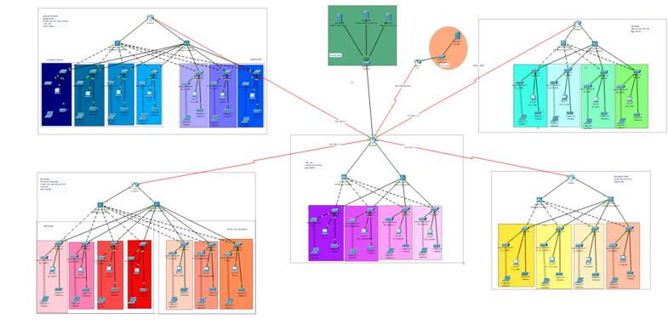

Slide 5

1- VLAN :
VLANs allow network segmentation, isolating traffic between different departments or user groups, which enhances security by limiting broadcast domains and reducing the risk of unauthorized access. Subnetting further divides IP addresses, organizing network traffic for efficient routing and improved performance.

Slide 6
DHCP :
DHCP servers automate IP address assignment, making it easier to manage dynamic devices like laptops and mobile phones. Static IP addresses are used for devices that require a fixed address, such as servers and printers. Proper configuration avoids IP conflicts and ensures reliable network communication.

Slide 7
BGP :
BGP is used for routing between different autonomous systems, making it suitable for large networks like a university campus. It enables scalable routing by efficiently managing routing paths, optimizing network traffic flow, and ensuring connectivity with external networks for services like internet access.

Slide 8
Redenduncy:
A hierarchical network model organizes the network into layers (Core, Distribution, and Access), making it more manageable, scalable, and flexible. Redundancy at each layer ensures that if one device or link fails, the network remains operational, minimizing downtime and enhancing reliability.

Slide 9
PAT (Port Address Translation) :
is a specific type of Network Address Translation (NAT) technique which is used in computer networking
Security: adds a layer of security by masking internal IP addresses from external networks
Access Control Lists (ACLs)

Slide 10
Security features :
Port security :
implementing switchport security (port-security) to control access .
SSH Access :
secure shell for remote management

Slide 11
Additional Services
Email Server: Setup for managing university email communication.
DNS Server: Name resolution for internal and external access.
Site-to-Site VPN: IPsec VPN to secure communication between campuses.

Slide 12
Testing & Validation
Importance of Testing: Rigorous testing for ensuring network reliability and security.
Key Test Areas:
1.VLAN and subnet configurations.
2.BGP routing and IPsec VPN.
3.Security features (Port Security, ACLs, SSH).

Slide 13
Conclusion
Key Takeaways:
1.A resilient, scalable, and future-ready network.
2.Infrastructure meets current needs and allows for future expansion.
3.Emphasis on security and redundancy to ensure operational reliability.

